Slide 1
INTERACTIVE TRANSPARENCY
BUILDING A Character IN ANIMATION.
PRESENTATION
BY
OLOTU EGEGUTI id: k1462892

Slide 2
INTRODUCTION
What is Animation: Animation is the process of displaying still images in a rapid sequence to create the illusion of movement. These images can be hand drawn, computer generated, or pictures of 3D objects
Aims of Animation: This study evaluate the degree to which computer animation contribute toward learning education /Commercial. With the increasing usability of animation, and every day usage in life, it is important to know how computer can develop children’s interest in discovering the created knowledge through animated stimulations in computer based environments.
This is an experimental’ study with the primary purpose of exploring the effectiveness of animations with text compare to graphics

Slide 3
AUTODESK MAYA 2016.
Modelling With Polygon
Starting with a Cube
I started with a Polygon cube and use a technique called box modelling to built the character. Here are the steps:
1. Choose Create > Polygon Primitives > Cube > Option Box.
2. In the polygon Cube Options window, input the following Values, as shown in

Slide 4
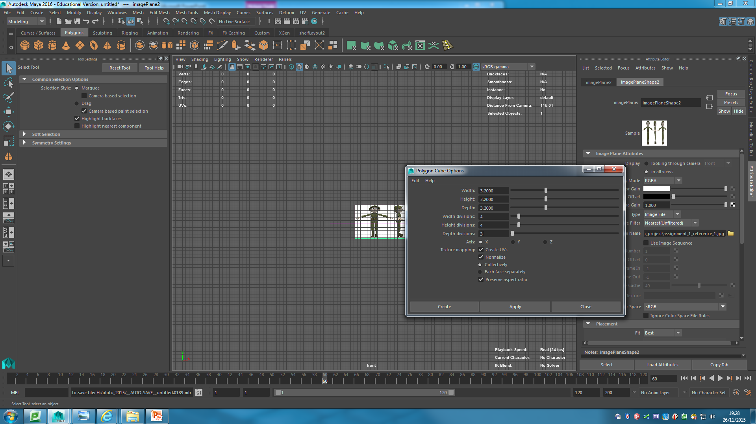

Slide 5
> Width, Height, Depth: 3.2
> With Divisions and Height Divisions: 4
> Depth Divisions: 3
3. Click the create button. A cube is created at the origin.
4. place the cursor in each view, and press the 5 key to shade the cube.
5. Select the move tool.
6. Click the cube (if it’s not already selected), and move it up so it covers the head in the front and side views, pan the views, down so you see the entire head in the sketch.

Slide 6
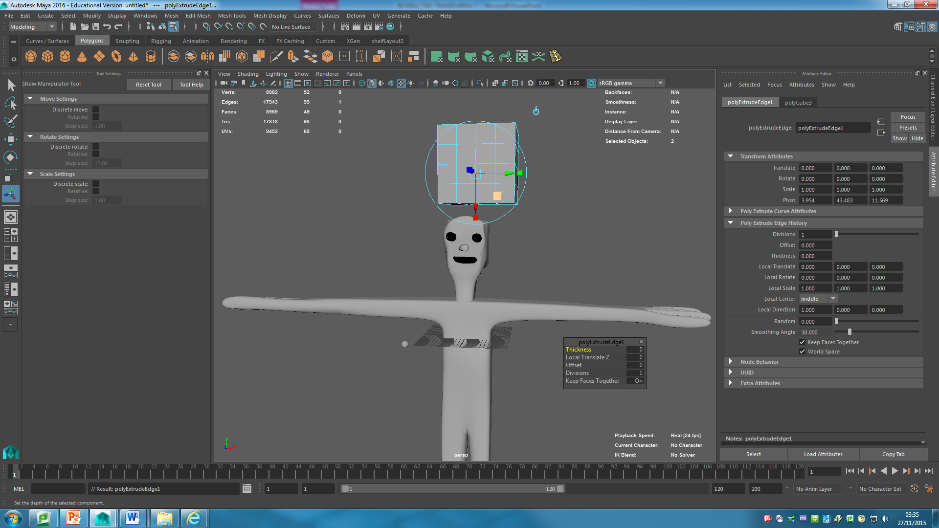
cube move
Extrude Face

Slide 7
You’ rough in the form of your character by using the extrude tool .then you add addition detail by using the insert edge loop and split polygon tools. Following these steps:
Make sure the drop-down menu in the upper –left corner of the interface is set polygons. Then click edited Mesh menu and verify the keep face together is checked as sown in here click it to check it.

Slide 8
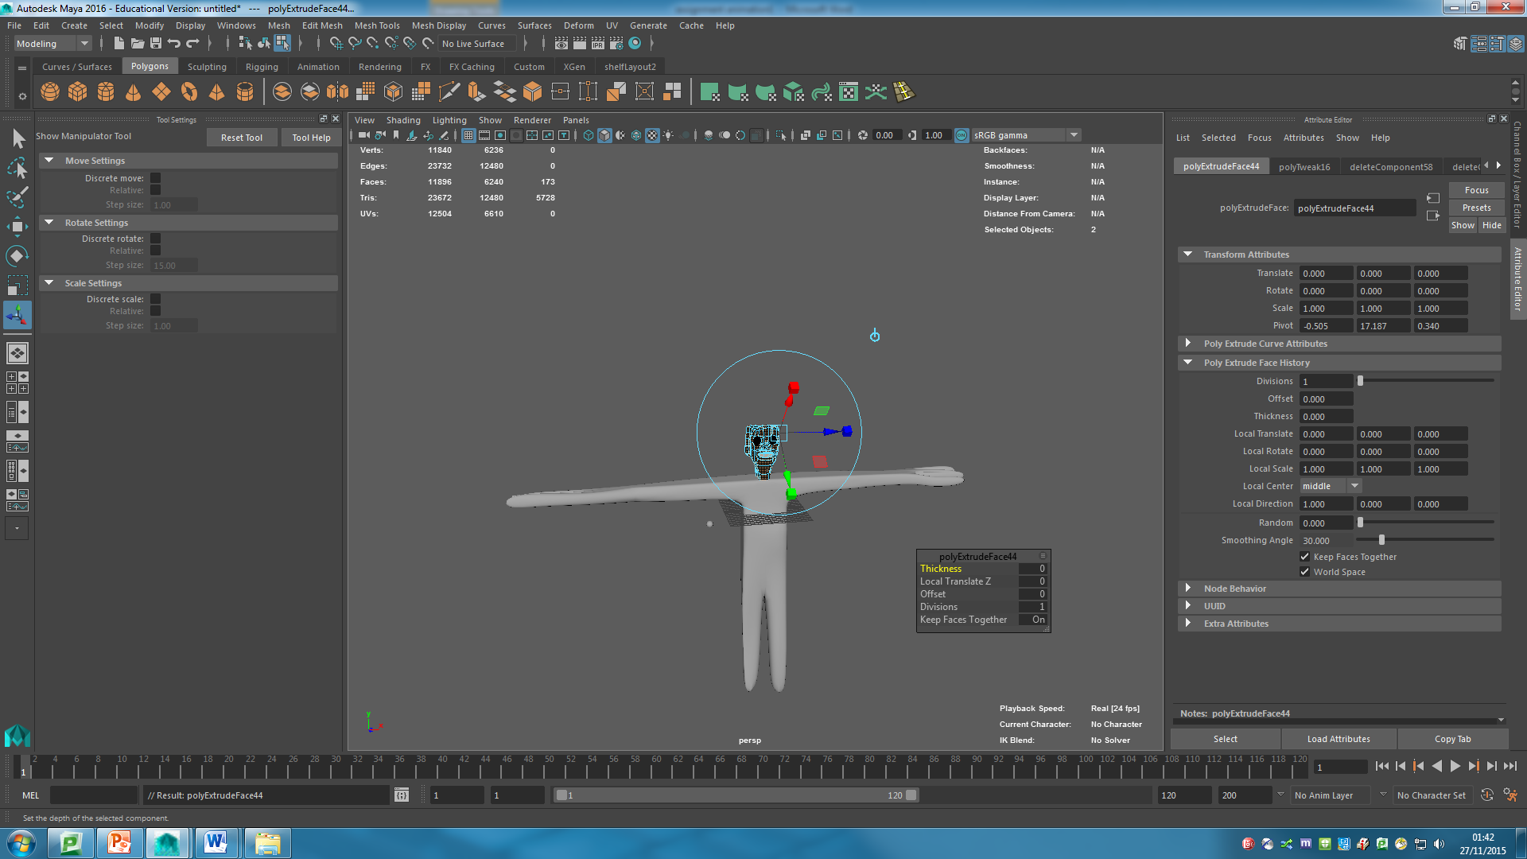
Moving extrude

Slide 9
BOX MODELING AND BUILDING A CHARACTER.
Now that I had extruded some faces from the cube, I had to extrude out the main shapes of the character. After you had those in, you’ go back and add detail with the insert Edge Loop and Split Polygon tools. Follow these steps:

Slide 10
1. With the bottom faces still selected, choose Edit Mesh > Extrude again, or press g on your key board. The g key repeats the last command you performed.
2.Click the blue arrowhead, and drag down to create a shoulder area.
3. Click the red cube (x scale), and drag to the right to scale the new faces to the width of the torso,

Slide 11
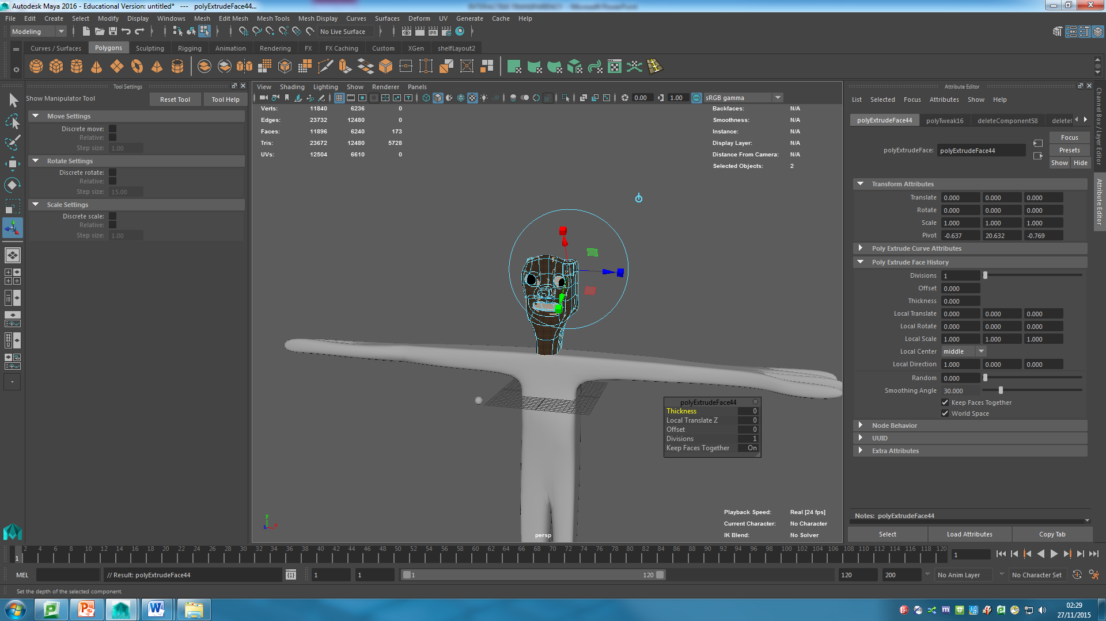
Scaling face

Slide 12
4. Press g to extrude another set of faces, and then drag them down the length of the torso. Select the x scale handles, and scale the faces so they’re the width of the bottom of the torso, as shown in page 11

Slide 13
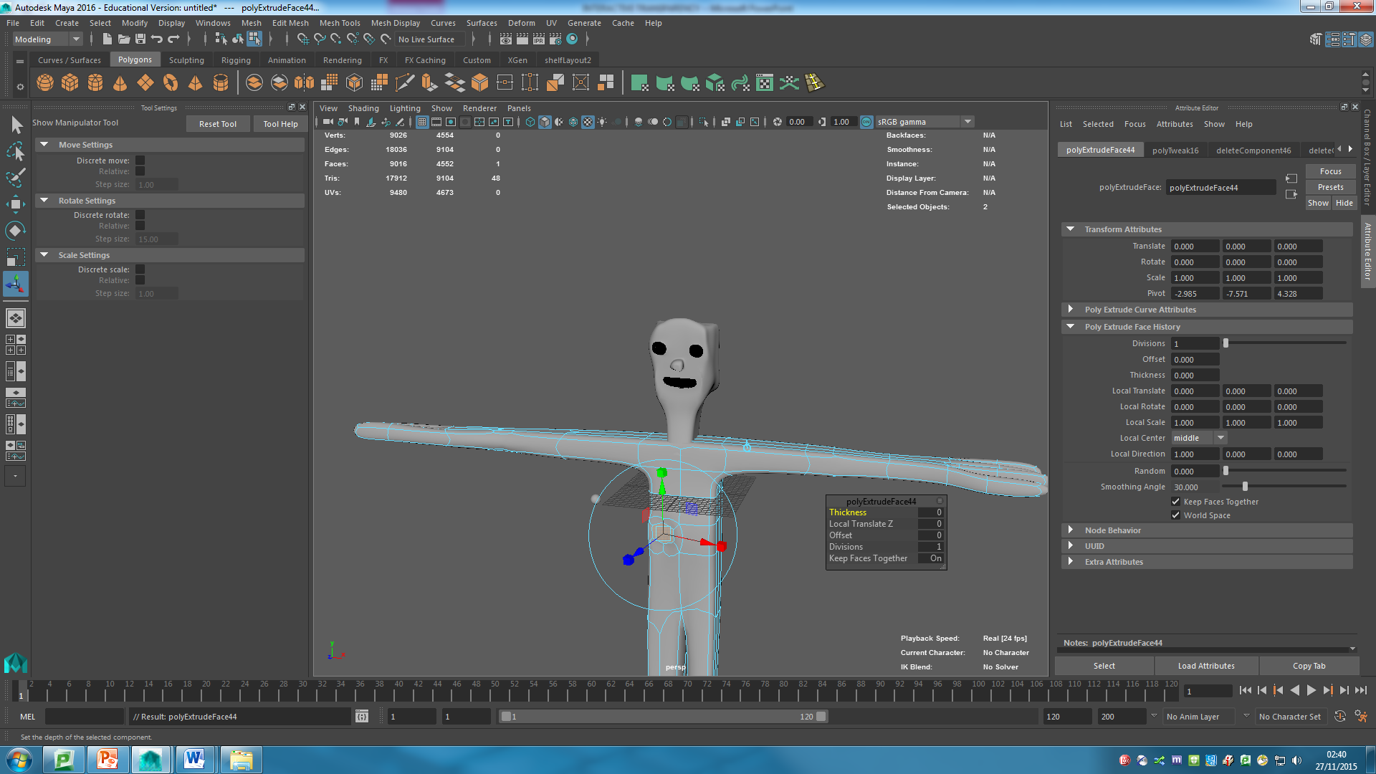
Extruding the torso

Slide 14
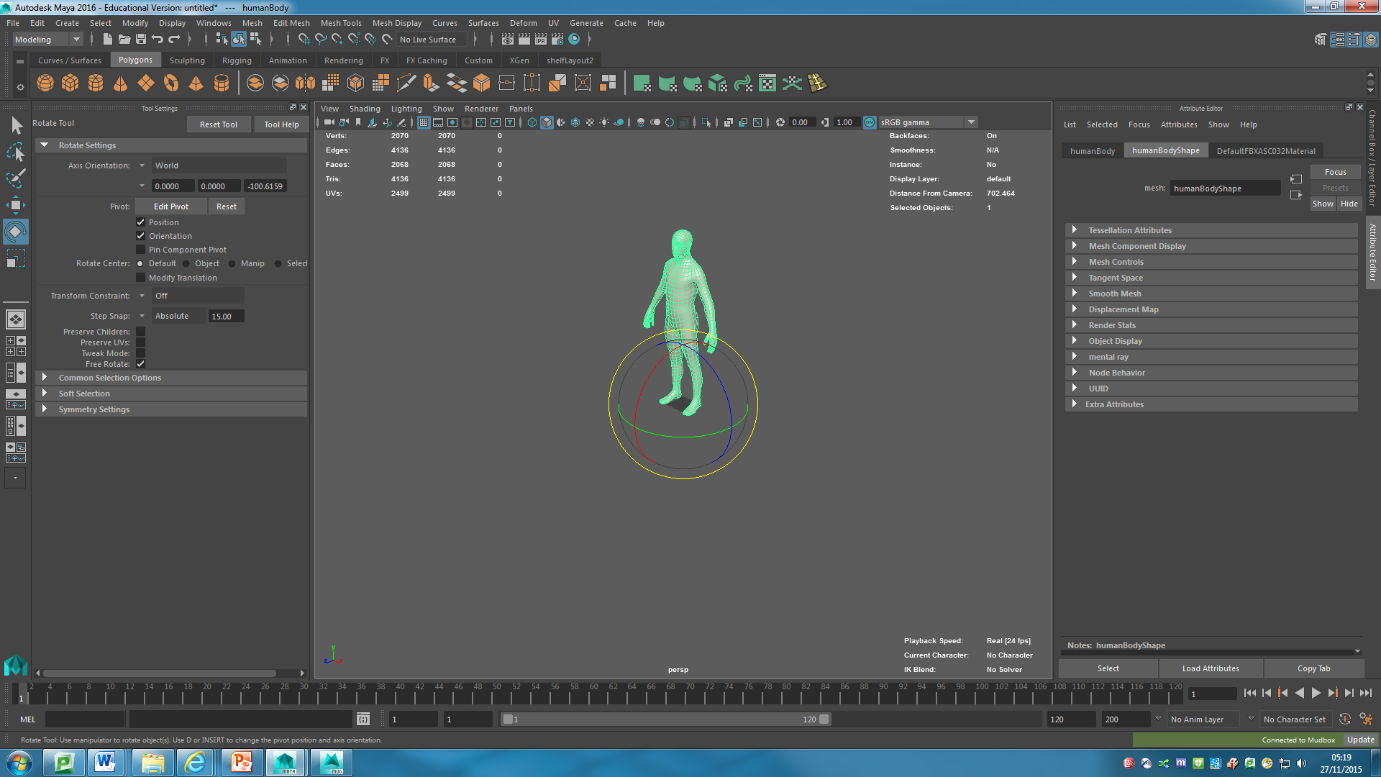
using rotate tool

Slide 15

Screens Displays
Projectors
Video Conferencing

Slide 16
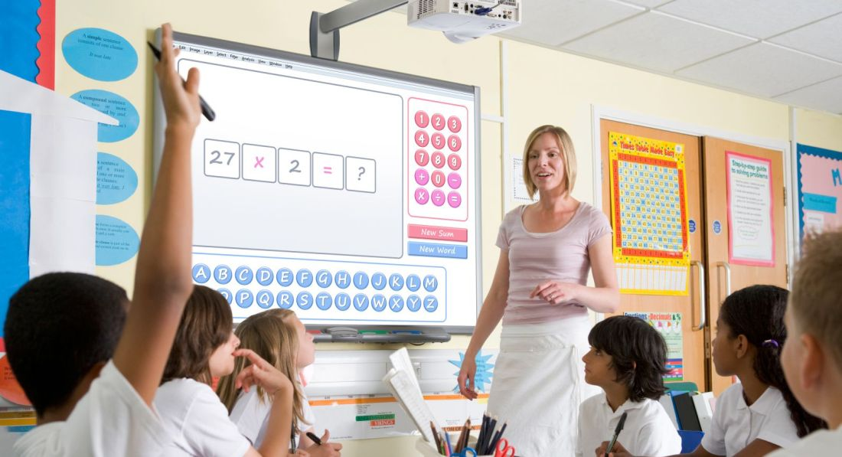

Slide 17
Lewcon AV are highly-experienced specialists in the provision of multimedia and audio visual solutions.

Slide 18
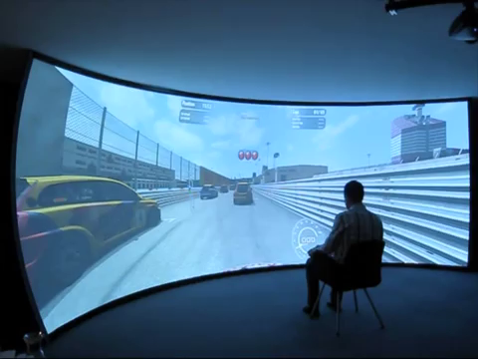
https://youtu.be/dOY2lREuwjU?t=1m25s

